Slide 1

Gene Functional Annotation Tools and Databases
Providing advanced genomic solutions!
zhangmin@novogene.cn
Notes:
大家好，欢迎大家参加诺禾致源的生物信息培训班。下面，我来介绍一些关于基因功能注释的工具和数据库的内容。高通量测序产生了大量的序列，这些序列有些是已有的或别人研究过的，有些是未知的，要研究这些序列，就要对他们进行功能注释。

Slide 2
Outline
What is functional annotation?
Popular tools - BLAST and HMMER
Nucleotide and protein databases
Gene functional annotation and classification
InterPro and InterProScan
Practice
Notes:
我介绍的内容主要包括以下几个方面

Slide 3
Outline
What is functional annotation?
Popular tools - BLAST and HMMER
Nucleotide and protein databases
Gene functional annotation and classification
InterPro and InterProScan
A simple example
Notes:
什么是功能注释

Slide 4
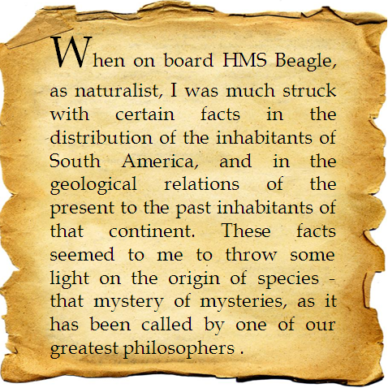
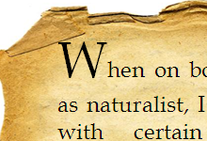
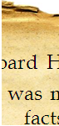
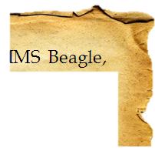
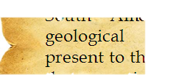
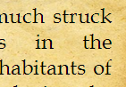
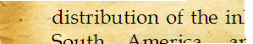
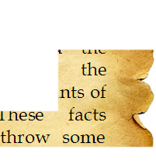
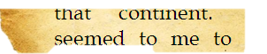
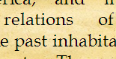
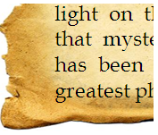
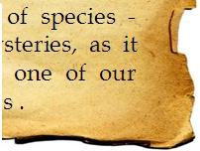
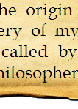
Genome Assembly
Assemble the Pieces Right
Notes:
我们把基因组拼接可以看作是，将撕碎的纸片拼成原来的完整的一张纸。

Slide 5

Gene Prediction
Identify the words
When on board HMS Beagle, as naturalist, I was much struck with certain facts in the distribution of the inhabitants of South America, and in the geological relations of the present to the past inhabitants of that continent. These facts seemed to me to throw some light on the origin of species - that mystery of mysteries, as it has been called by one of our greatest philosophers .
When on board HMS Beagle, as naturalist, I was much struck with certain facts in the distribution of the inhabitants of South America, and in the geological relations of the present to the past inhabitants of that continent. These facts seemed to me to throw some light on the origin of species - that mystery of mysteries, as it has been called by one of our greatest philosophers .
Notes:
基因预测相当于找出纸片上的单词

Slide 6
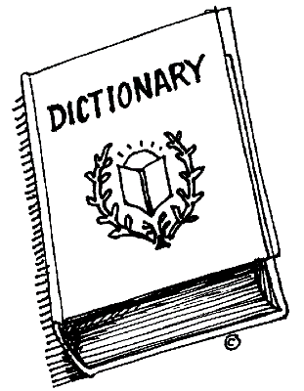
Functional Annotation
nat·u·ral·ist [nach-er-uh-list, nach-ruh-]
noun
1. a person who studies or is an expert in natural history, especially a zoologist or botanist.
2. an adherent of naturalism in literature or art.
Origin: 1580–90; natural + -ist
Identify the function (i.e., meaning) of each word
When on board HMS Beagle, as naturalist, I was much struck with certain facts in the distribution of the inhabitants of South America, and in the geological relations of the present to the past inhabitants of that continent. These facts seemed to me to throw some light on the origin of species - that mystery of mysteries, as it has been called by one of our greatest philosophers .
DATABASES
PROFILES
Origin of Species, The
noun
( On the Origin of Species by Means of Natural Selection, or the Preservation of Favoured Races in the Struggle for Life ) a treatise (1859) by Charles Darwin setting forth his theory of evolution.
Notes:
而功能注释就是找出每个单词的含义，在这个过程中，字典相当于功能注释的数据库，而查找的方法就是功能注释的工具。那么，在生物序列的注释中，需要什么样的信息进行功能注释呢？

Slide 7
What information can be used for functional annotation?
Sequence based approaches
Protein A has function X, and protein B is a homolog (ortholog) of protein A; Hence B has function X
Structure based approaches
Protein A has structure X, and X has so-so structural features; Hence A’s function sites are
Motif based approaches (sequence motifs, 3D motifs)
A group of genes have function X and they all have motif Y; protein A has motif Y; Hence protein A’s function might be related to X
“Guilt-by-association”
Gene A has function X and gene B is often “associated” with gene A, B might have function related to X
Domain fusion, phylogenetic profiling, PPI, etc
Notes:
主要有一下四个方面，首先是以序列为基础的方法，以结构为基础的方法，以motif为基础的方法和相关分析的方法。
在这四种方法中，最长用的是以序列为基础的方法和以结构为基础的方法，相应的生物信息工具有BLAST和HMMER。

Slide 8
Outline
What is functional annotation?
Popular tools - BLAST and HMMER
Nucleotide and protein databases
Gene functional annotation and classification
InterPro and InterProScan
A simple example

Slide 9
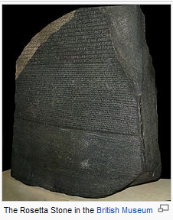
Biological Sequences
Sequence similarity is a powerful tool for discovering biological function. Just as the ancient Greeks used comparative anatomy to understand the human body and linguists used the Rosetta stone to decipher Egyptian hieroglyphs, today we can use comparative sequence analysis to understand genomes, RNAs, and proteins. But why are biological sequences similar to one another in the first place? The answer to this question isn't simple and requires an understanding of molecular and evolutionary biology.
Biological sequences like proteins may have important functions necessary for the survival of an organism. But DNA sequence can mutate randomly, and this may change how a sequence functions. Over time, both functional constraints and random processes impact the course of sequence evolution. The degree to which a sequence follows a functional or random path depends on natural selection and neutral evolution. So the reason why sequences are similar to one another is because they start out similar to one another and follow different paths.
Notes:
通过序列相似性挖掘生物功能是最有效的工具。早在古希腊，人们通过rosetta stone通过相似比较的方法解读埃及的象形文字。现如今，我们用序列比较来分析生物序列。为什么生物序列间具有相似性呢？这就涉及到了分子进化。生物序列比如蛋白具有重要的功能，来维系生物的生存，而DNA序列发生随即突变，这就导致生物序列在物种间具有差异性，同时也是保守的。而BLAST算法就是通过序列相似性寻找同源基因的方法。

Slide 10
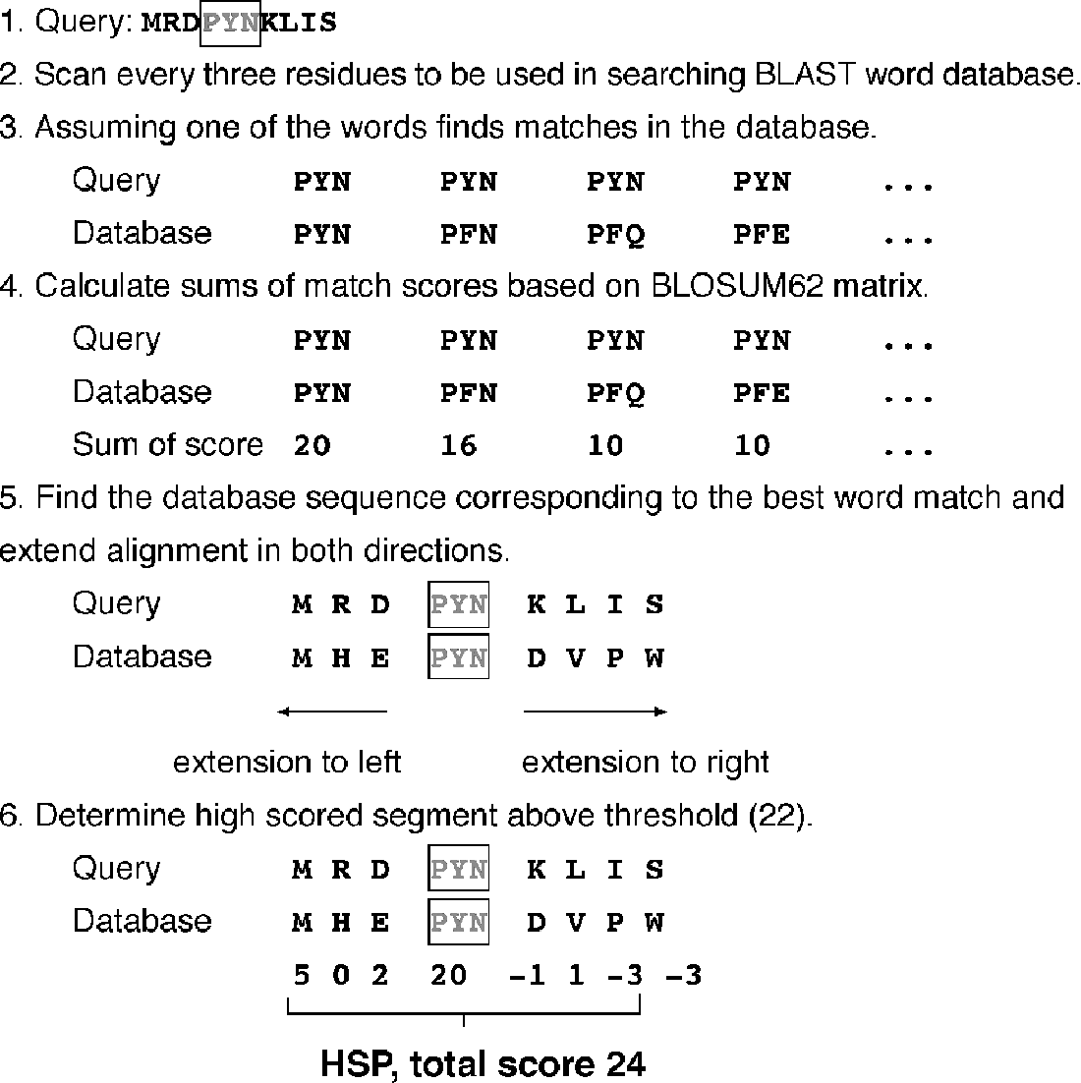
Basic Local Alignment Search Tool
Divide a query sequence into short chunks called words,
Look for exact matches
in case of hit try extending the alignment
Notes:
BLAST全称是Basic Local Alignment Search Tool，首先要查询的序列会被分成短的片段，将这样每个短片段在数据库中查询。
找出完全或部分匹配的结果后，会对其打分，比如。。。，将分值最高的配对，从两边延伸，

Slide 11
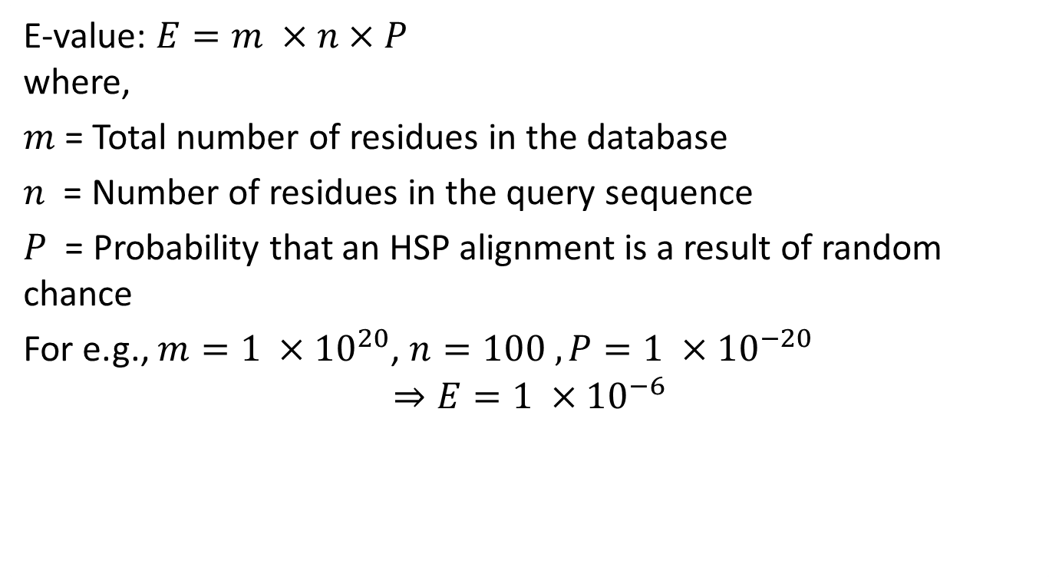
Statistical assessment
E-value: $E=m ×n×P$ where,
$m$ = Total number of residues in the database
$n$ = Number of residues in the query sequence
$P$ = Probability that an HSP alignment is a result of random chance
For e.g., $m=1 ×{10}^{20}$, $n=100 , P=1 ×{10}^{−20}$
$$⇒E=1 ×{10}^{−6}$$

Slide 12
Different flavors!
BLASTN
Queries nucleotide vs. nucleotide sequences
BLASTP
Queries protein vs. protein sequences
BLASTX
Queries 6 possible frames of nucleotide sequences vs. protein sequences
TBLASTN
Reciprocal of BLASTX（库和核算序列都翻译成6框）
TBLASTX
Queries 6 possible frames of nucleotide sequences vs. 6 possible frames of nucleotide sequences inside the database

Slide 13

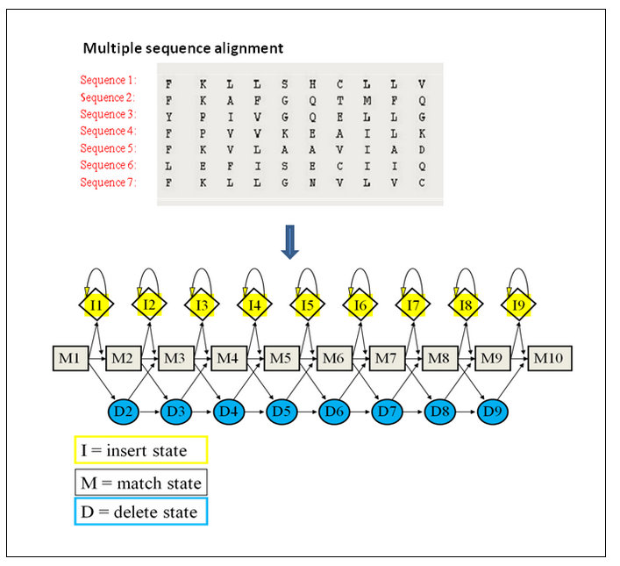
HMMER
HMMER is used for searching sequence databases for homologs of protein sequences, and for making protein sequence alignments. It implements methods using probabilistic models called profile hidden Markov models (profile HMMs).
Representation of a Hidden Markov model based on a multiple sequence alignment.
Notes:
HMMER是一种不同于BLAST的蛋白同源序列搜索工具，它根据多序列比对的结果，建立了一个隐马尔科夫的概率模型。
简单的讲HMMER就是一款比对软件，可以类似于blast等，但是它提供的比对结果要精确于blast,相应的速度也要慢。与其类似的比对软件有PSI-blast、SAM、PFTOOLS等。
用途一：对于一条未知的序列在蛋白质数据库中寻找比对，HMMER完全可以取代目前常用的BLASTP 和 PSI-BLAST。
用途二：可以自动注释蛋白质结构域。包括pfam、SMART。
用途三：在数据库中寻找已有家族的相似序列。

Slide 14
HMMER algorithms
hmmscan - search protein sequences against collections of profiles, e.g. Pfam. In HMMER2 this was called hmmpfam.
hmmsearch - used to search one or more profiles against a protein sequence database.
jackhmmer - iteratively search a query protein sequence, multiple sequence alignment or profile HMM against the target protein sequence database.
phmmer - used to search one or more query protein sequences against a protein sequence database.

Slide 15
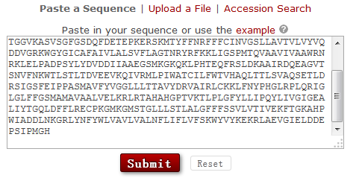
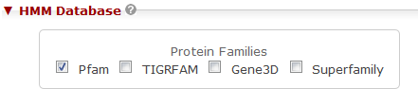
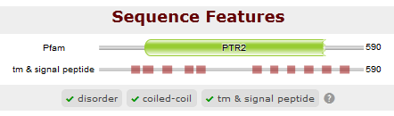
http://hmmer.janelia.org/search/hmmscan

Slide 16
Outline
What is functional annotation?
Popular tools - BLAST and HMMER
Nucleotide and protein databases
Gene functional annotation and classification
InterPro and InterProScan
A simple example

Slide 17
Nucleotide and protein databases
NCBI (USA), EMBL (Europe), DDBJ (Japan)
EST, STS, GSS, Genomes, RefSeq, HTG, etc.
International Nucleotide Sequence Database Collaboration
Genbank
CoreNucleotide - Nt/Nr
dbEST
dbGSS

Slide 18
NCBI Nt/Nr
Nt - Nucleotide collection
The nucleotide collection consists of GenBank+ EMBL+ DDBJ+ PDB+RefSeq sequences, but excludes EST, STS, GSS, WGS, TSA, patent sequences as well as phase 0, 1, and 2 HTGS sequences. The database is partially non-redundant.
Nr - Non-redundant protein sequences
All non-redundant GenBank CDS translations+PDB +SwissProt + PIR+PRF excluding environmental samples from WGS projects.

Slide 19
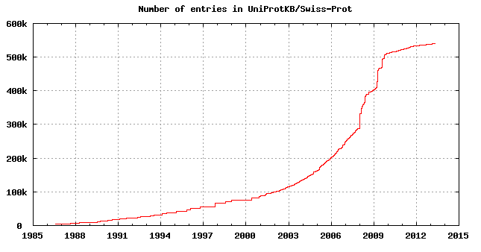
UniProtKB/Swiss-Prot
UniProtKB - Protein knowledgebase, consists of two sections:
SwissProt: manually annotated and reviewed.
TrEMBL: automatically annotated and is not reviewed.

Slide 20



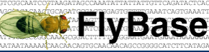



Model Organism Genomes

Slide 21
Useful Tools
Key word search
BLAST, BLAT
Genome browse
Biomart
Other functional resourse

Slide 22
Outline
What is functional annotation?
Popular tools - BLAST and HMMER
Nucleotide and protein databases
Gene functional annotation and classification
InterPro and InterProScan
A simple example

Slide 23
Gene functional annotation and classification
To interpret a protein in the context of biological function
Protein domains, families, functional sites, pathways or other biological meaningful aspects
Protein domain family, PFAM
Gene ontology
KEGG pathway
KOG/COG
… …

Slide 24
PFAM
The Pfam database is a large collection of protein families, each represented by multiple sequence alignments and hidden Markov models (HMMs).
14831 families, high quality Pfam-A, low quality Pfam-B.
Annotation tools: hmmscan (HMMER 3.0)
Notes:
Pfam数据库是蛋白结构域家族的数据库，收集了各物种的蛋白家族信息，包括了多序列排列和根据多序列排列建立的隐马尔科夫概率模型。

Slide 25
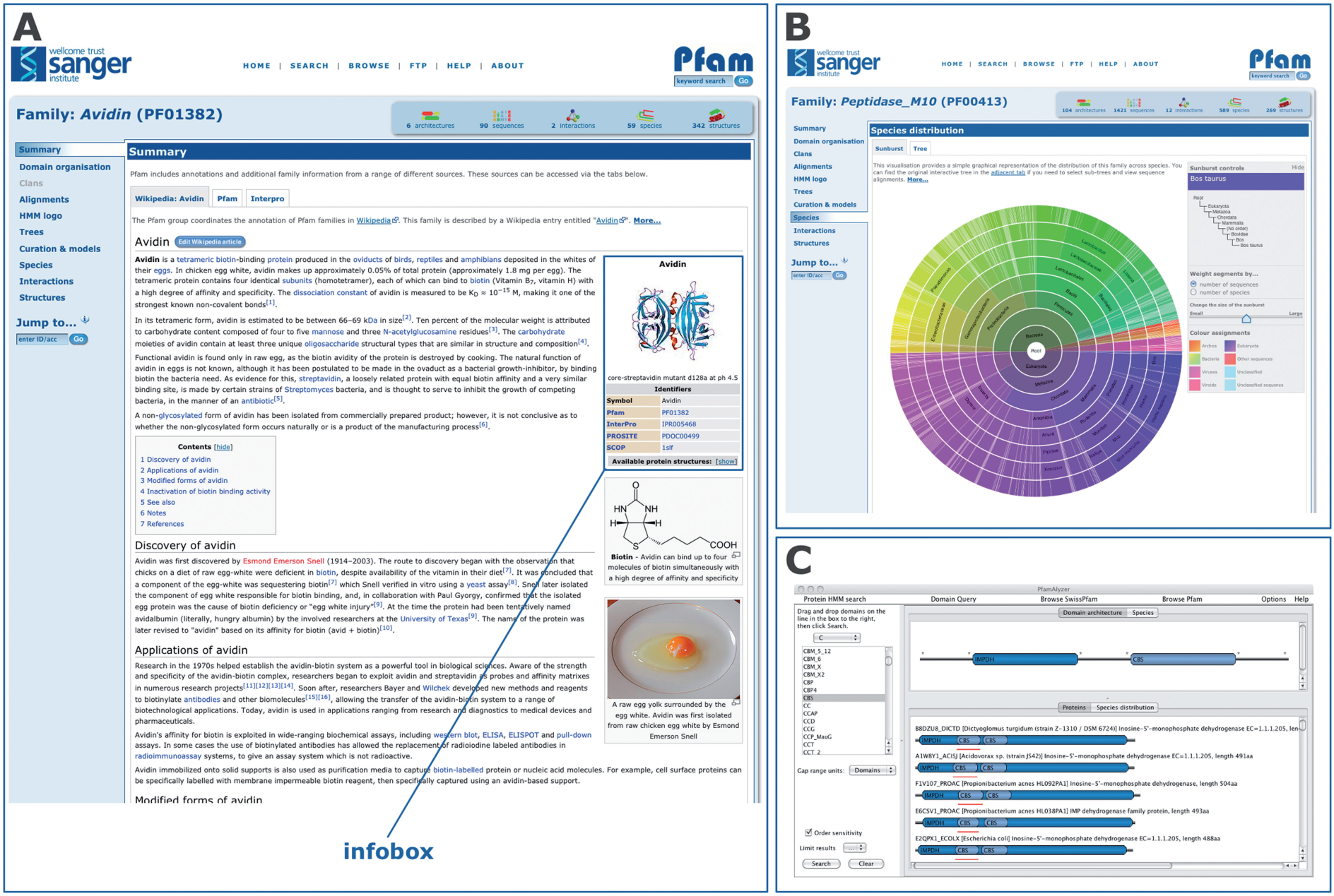
PFAM features
Notes:
New Pfam features since release 24.0. (A) The Pfam-A family page for Avidin (PF01382), showing the embedded contents of the associated
Wikipedia article. The ‘infobox’ is highlighted. (B) The ‘sunburst’ representation of the tree showing the species distribution of the Pfam-A family
Peptidase_M10 (PF00413). (C) The PfamAlyzer applet, showing the results of searching for all architectures that include the domains IMPDH and
CBS. The PfamAlyzer applet allows querying of Pfam for proteins with particular domains, domain combinations or architectures.

Slide 26
Gene Ontology
Aim to standardizing the representation of gene and gene product attributes across species and databases.
GO covers three domains: biological process, cellular component and molecular function.
For example, Cytochrome P450 11B1, mitochondrial

Slide 27
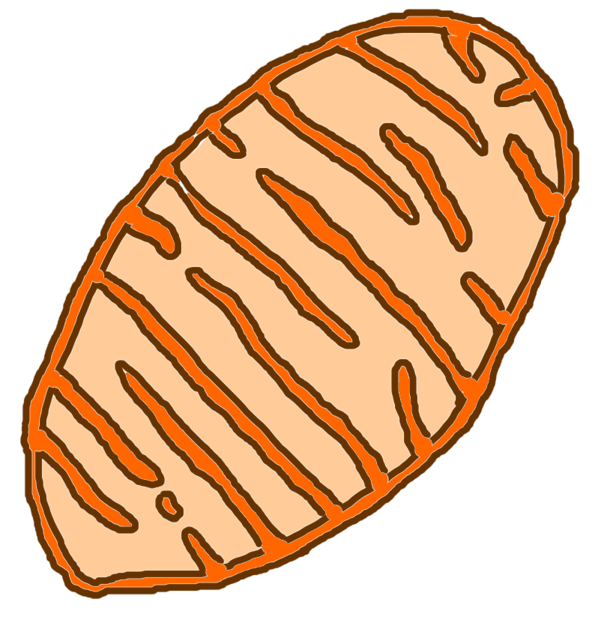
Where is it?
Mitochondrial
p450
mitochondrial inner
membrane
GO cellular component term:
GO:0005743
Notes:
The mitochondrial p450 gene products are localised on the mitochondrial inner membrane and the GO cellular component term for this is mitochondrial inner membrane ; GO:0005743

Slide 28
What does it do?
substrate + O₂ = CO₂ +H₂O + product
monooxygenase activity
GO molecular function term:
GO:0004497
Notes:
The function of the gene product is described by the GO molecular function term:
monooxygenase activity ; GO:0004497

Slide 29
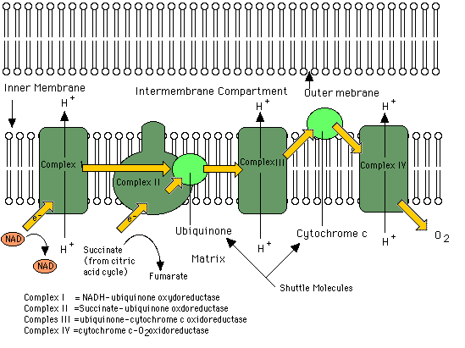
Which process is this?
electron transport
GO biological process term:
GO:0006118
Notes:
The process in which the gene product is involved is GO biological process term:
electron transport ; GO:0006118
In this way you can see that many aspects of a single gene product can be recorded simply by annotating it to the three ontologies.

Slide 30
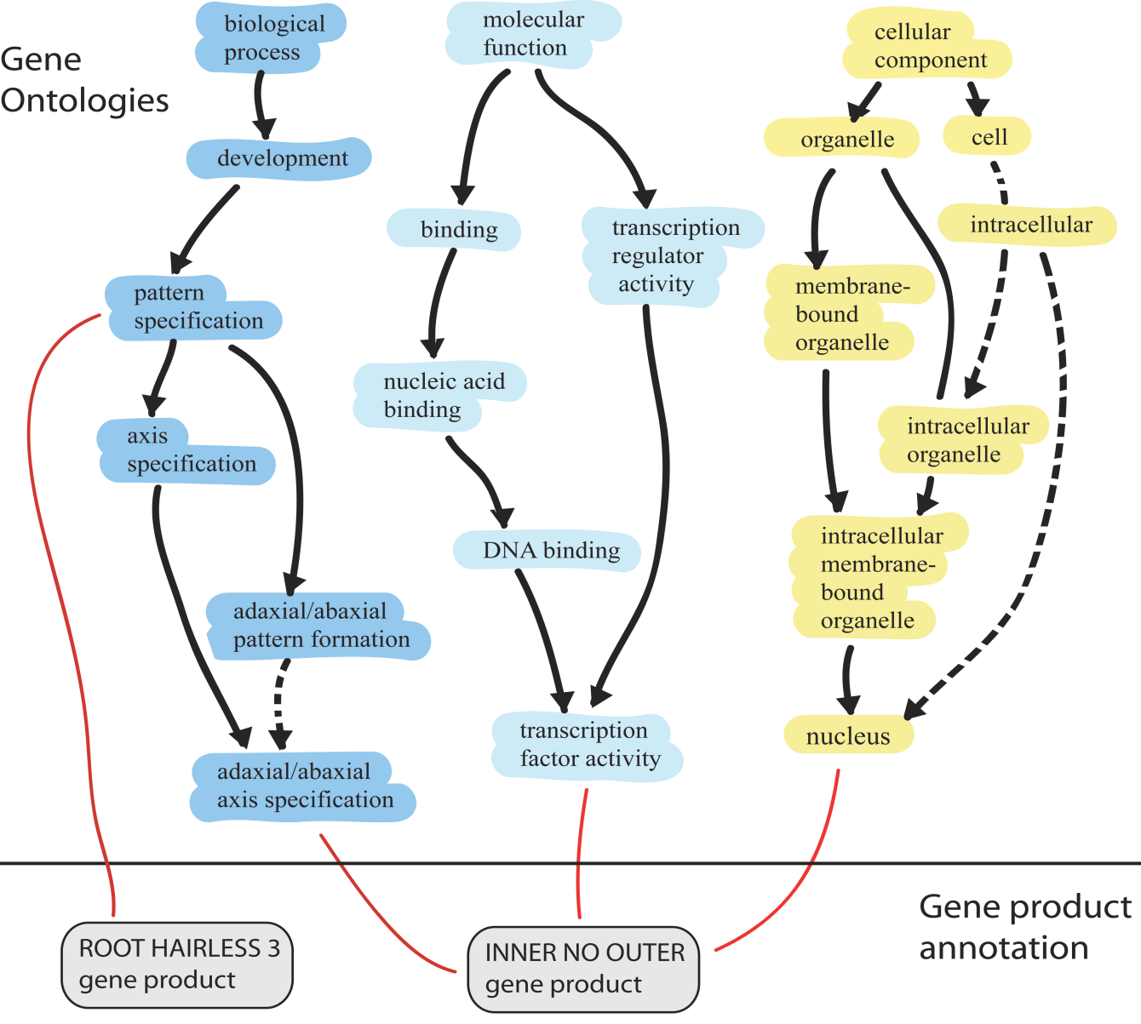
DAG
is_a
part_of

Slide 31
GO Annotation
Mappings to GO
EC2GO, Pfam2GO, COG2GO
Annotation tools
Blast2go
Goanna
Gotcha
…

Slide 32

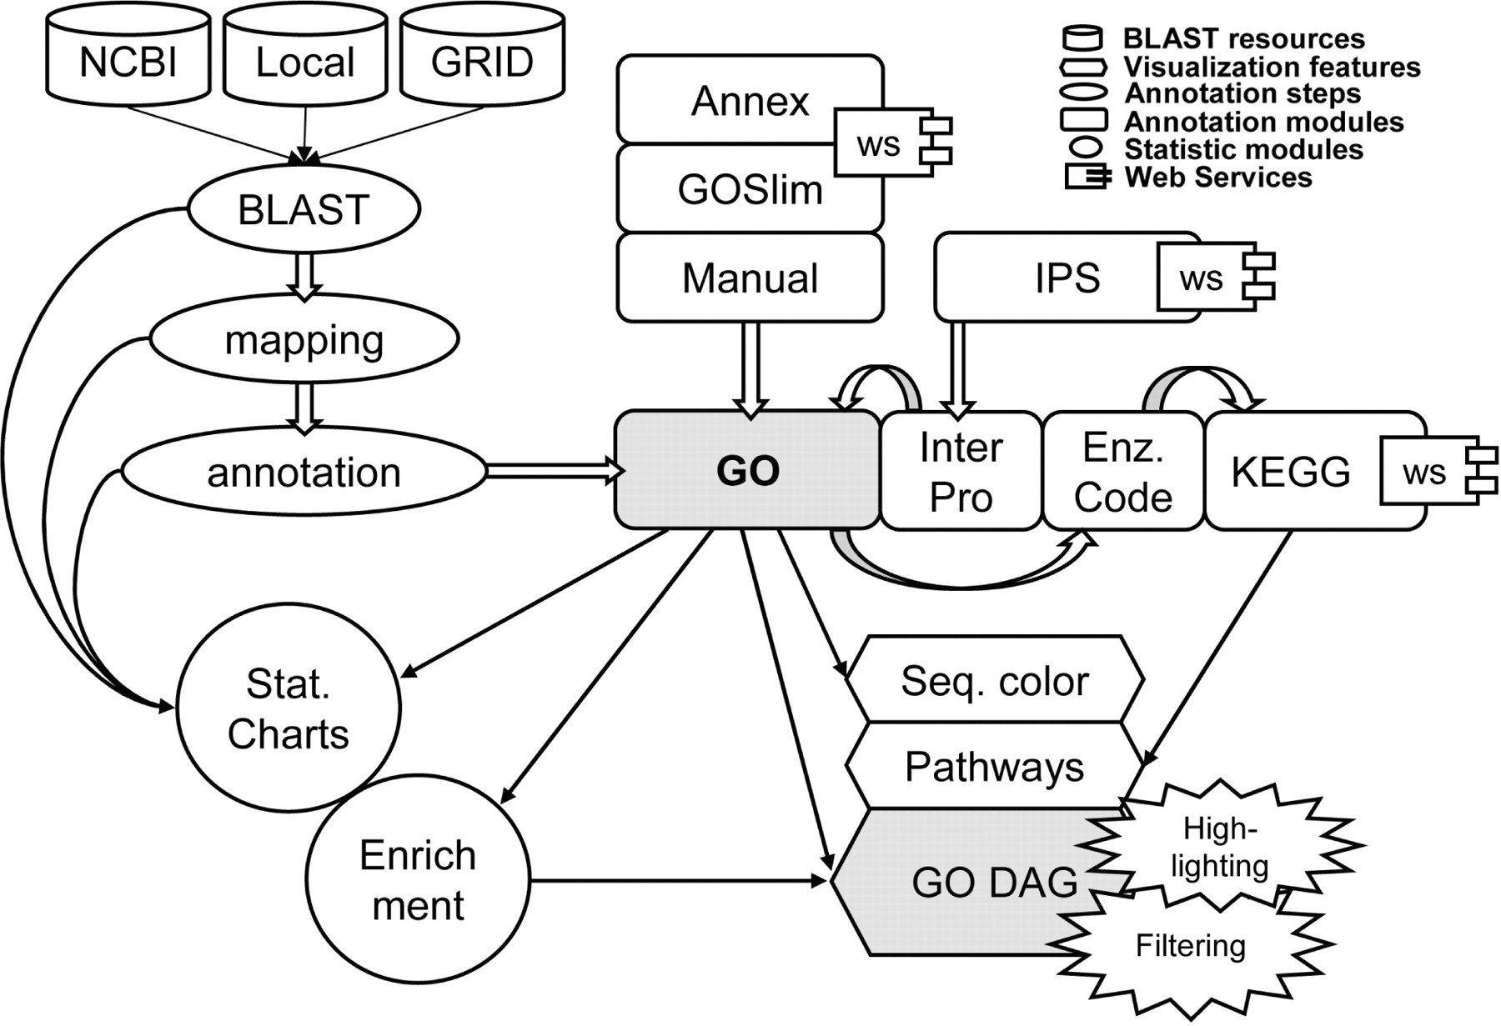

Slide 33
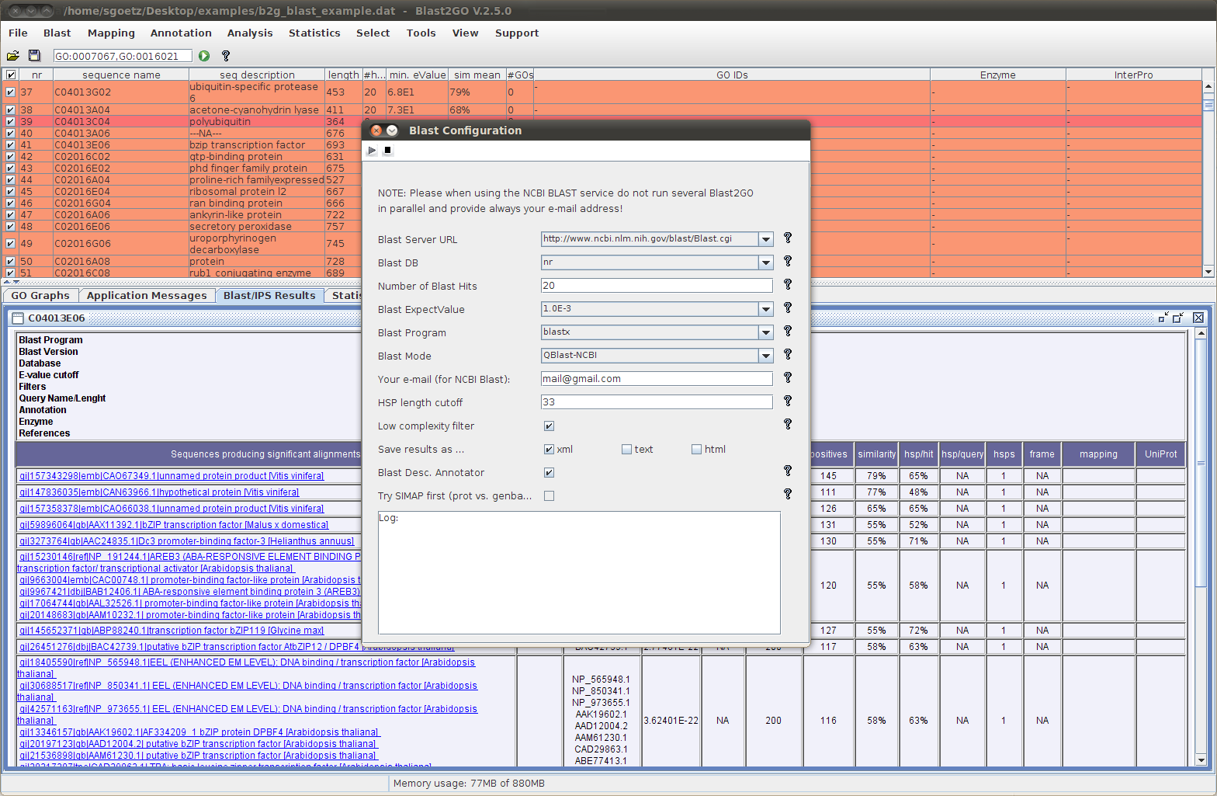
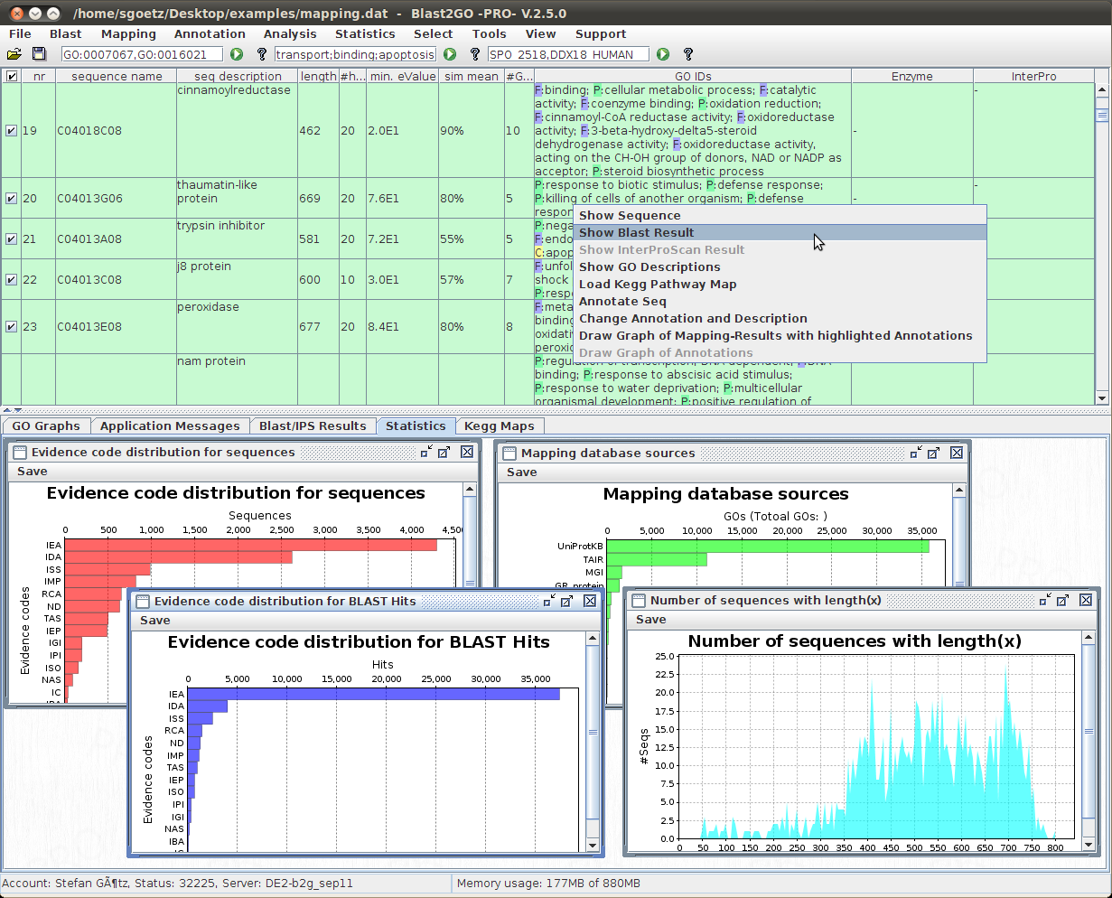
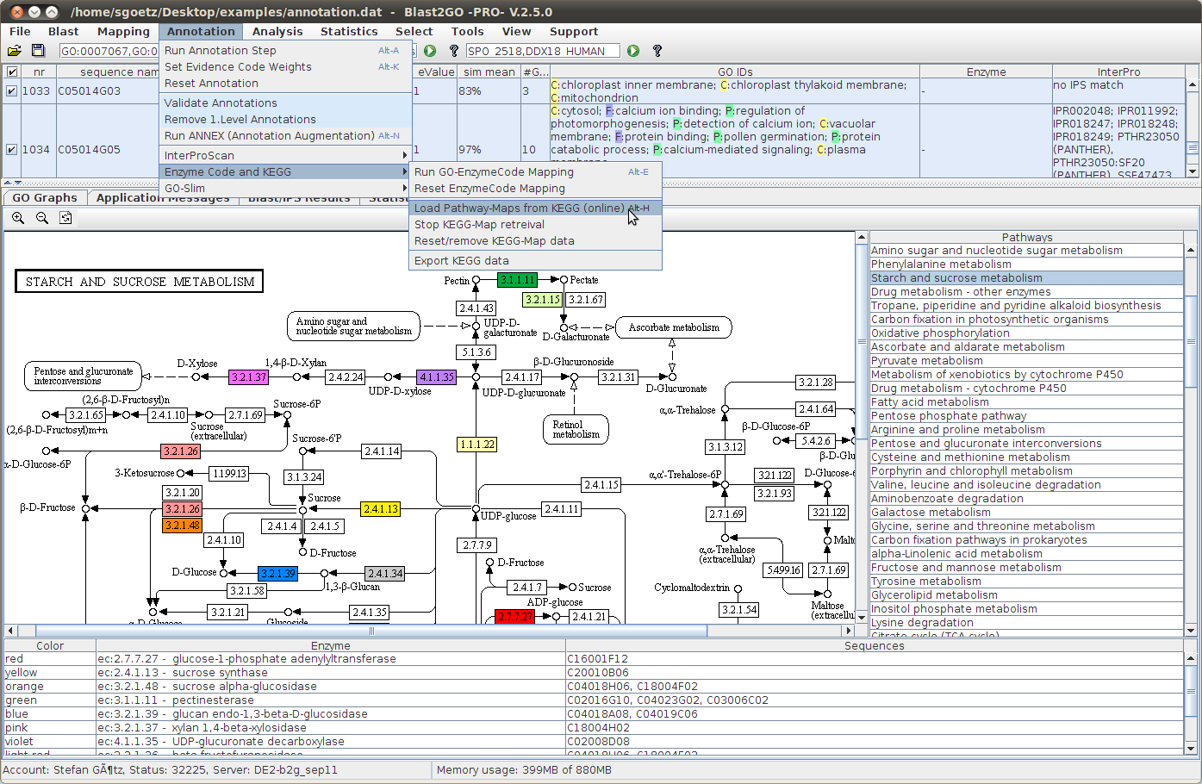
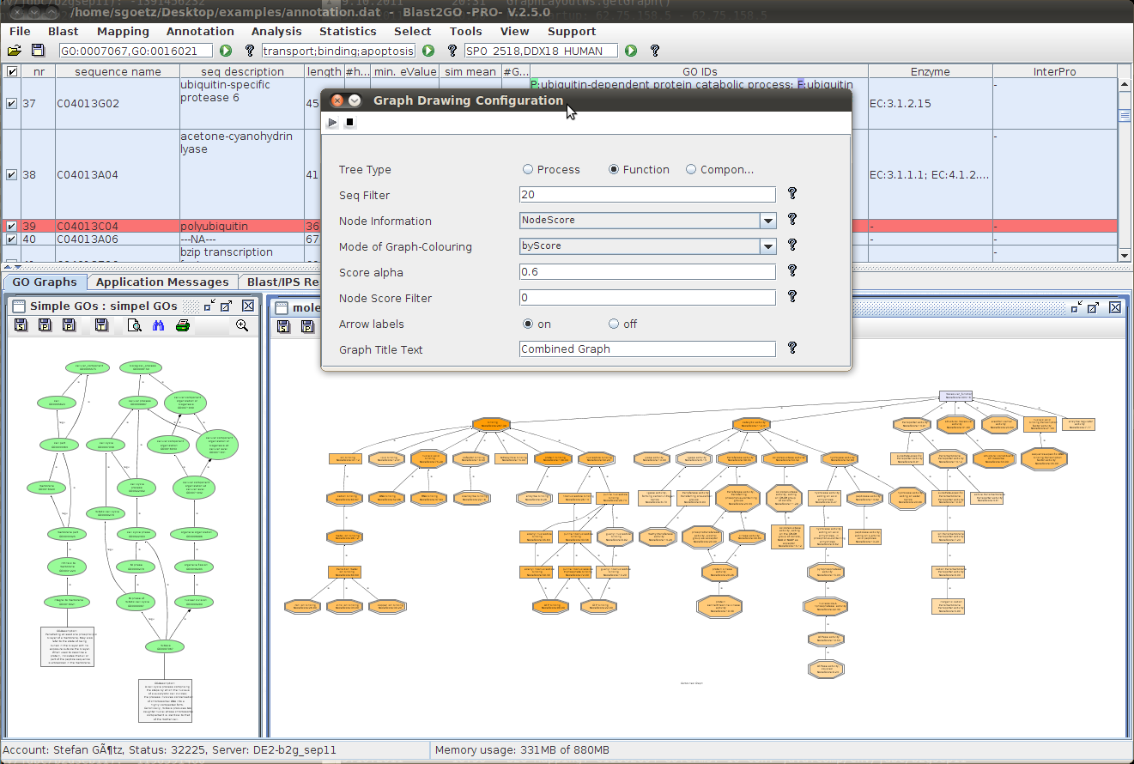

Slide 34
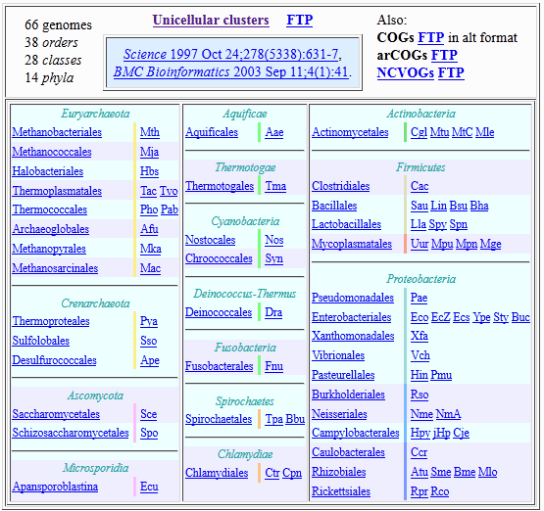
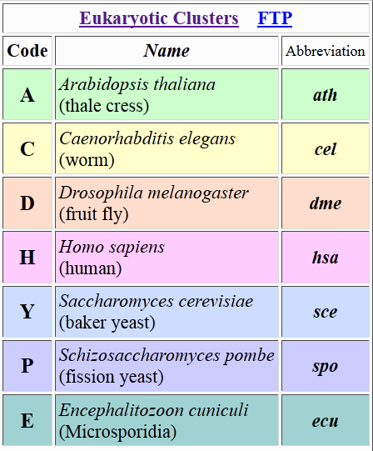
COG/KOG
Clusters of Orthologous Groups of proteins
euKaryotic Ortholog Groups

Slide 35
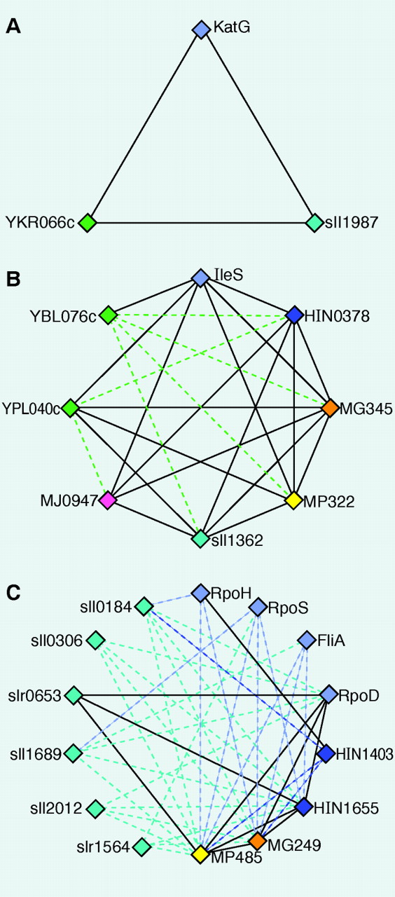
How to define ortholog?
Bet - best hit
Each COG included proteins from at least three sufficiently distant species
?

Slide 36
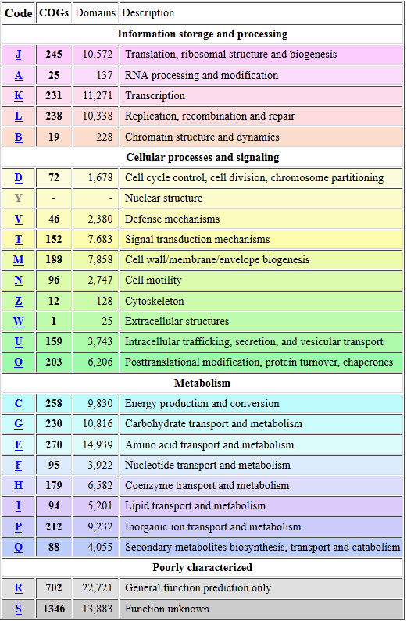
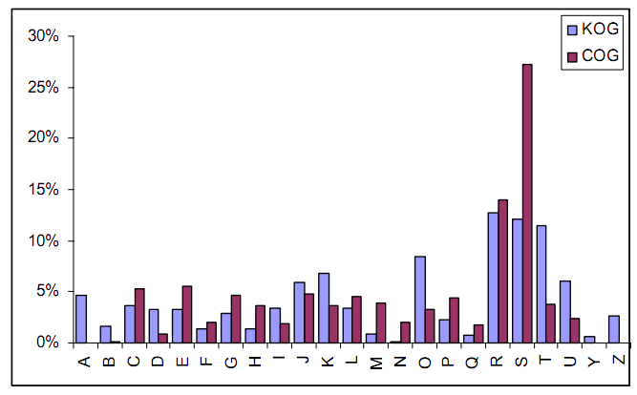
COG/KOG

Slide 37
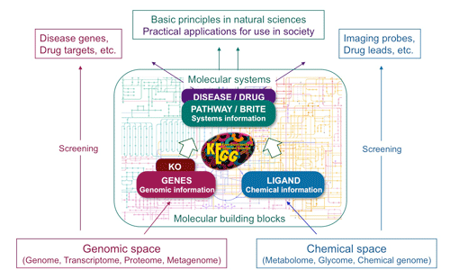
Kyoto Encyclopedia of Genes and Genomes
KEGG (Kyoto Encyclopedia of Genes and Genomes) is a collection of online databases dealing with genomes, enzymatic pathways, and biological chemicals. The PATHWAY database records networks of molecular interactions in the cells, and variants of them specific to particular organisms.
Kanehisa Laboratories

Slide 38
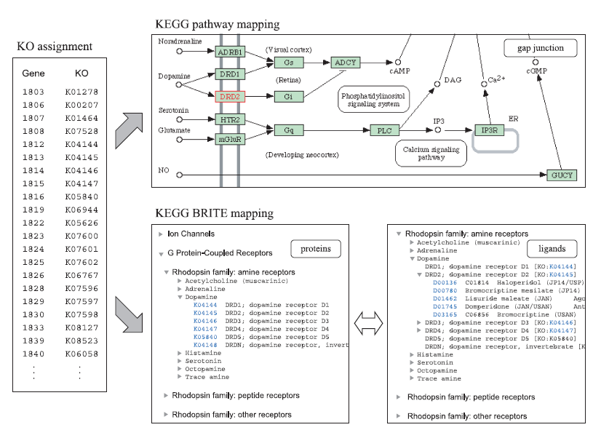
KEGG orthology
KAAS, for ortholog assignment and pathway mapping
A set of represent genomes, bi-directional best hit

Slide 39
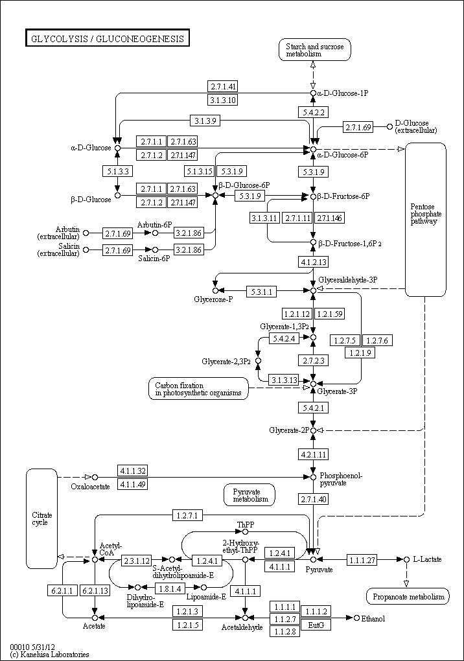
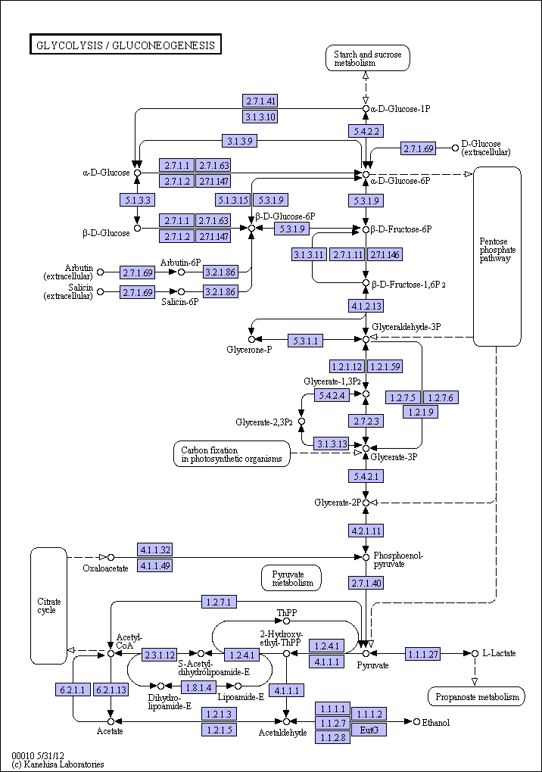
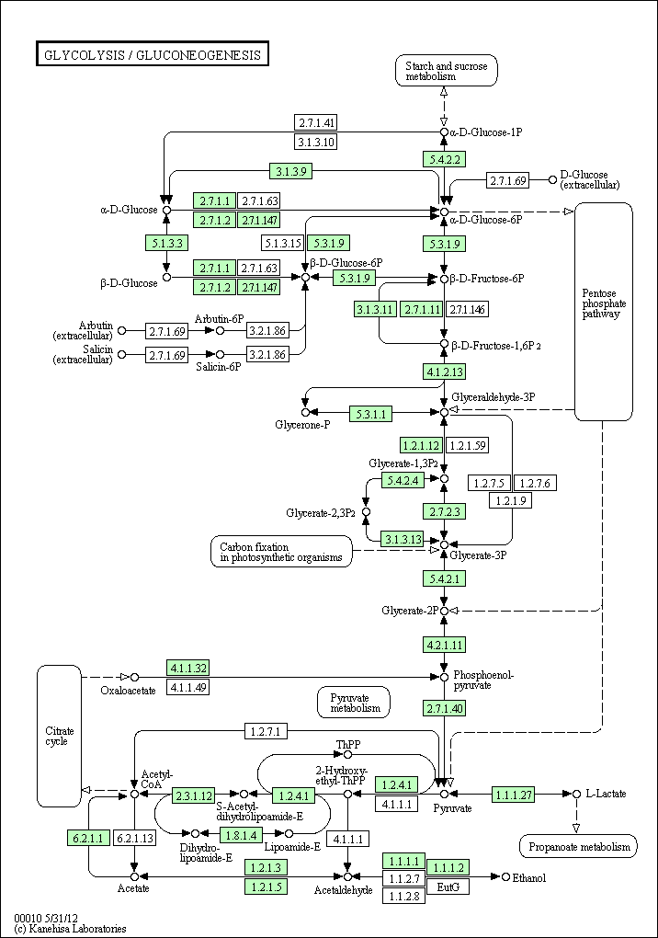
KEGG pathway
map00010
ko00010
hsa00010
Glycolysis / Gluconeogenesis

Slide 40
KEGG API
http://rest.kegg.jp/<operation>/<argument>/<argument2 or option>
<operation> = info | list | find | get | conv | link
<argument> = <database> | <dbentries>
<database>: path for kegg pathway, ko for kegg orthology …
<dbentries>: <dbentry> + <dbentry>+ …
TASK
Get a kegg pathway map.
Get gene list that involve that pathway.

Slide 41
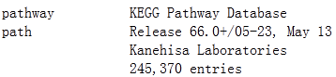
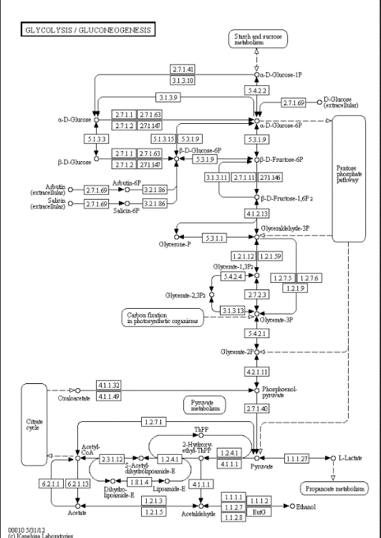
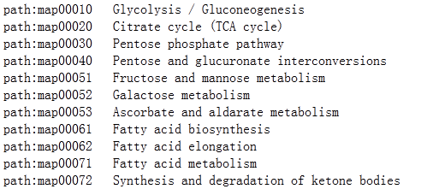
TASK 1
Get a kegg pathway map.
http://rest.kegg.jp/info/pathway
http://rest.kegg.jp/get/map00010/image
http://rest.kegg.jp/list/pathway
Glycolysis / Gluconeogenesis

Slide 42
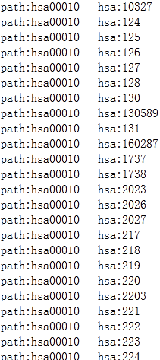
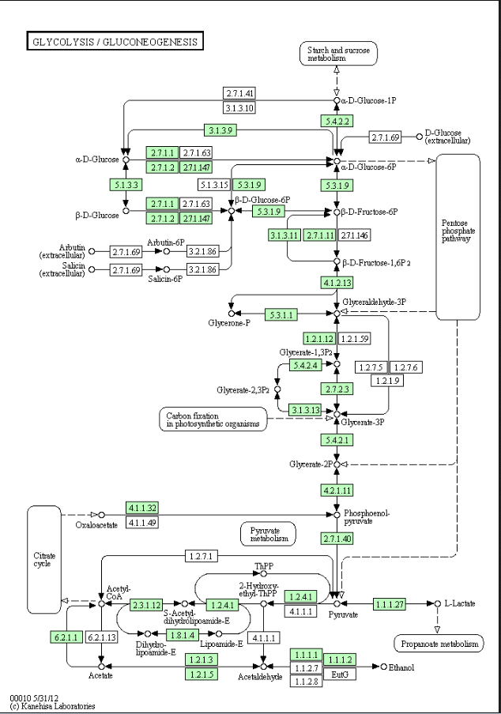
TASK 2
Get gene list that involve that pathway.
http://rest.kegg.jp/get/hsa00010/image
http://rest.kegg.jp/link/hsa/hsa00010

Slide 43
Outline
What is functional annotation?
Popular tools - BLAST and HMMER
Nucleotide and protein databases
Gene functional annotation and classification
InterPro and InterProScan
A simple example

Slide 44

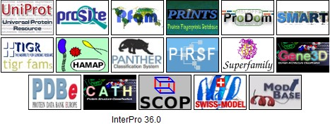
InterPro, protein sequence analysis & classification
Current release: 42.0 4th April 2013

Slide 45
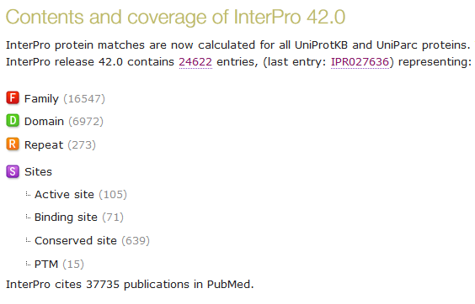

Slide 46
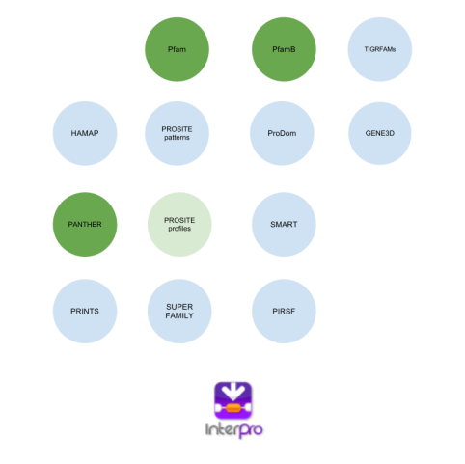
Querying with InterProScan
“Sequence-based queries are performed using InterProScan, a tool that combines the different protein signature recognition methods native to the InterPro member databases into one resource.”
Query Sequence
InterProScan

Slide 47

Querying with InterProScan
Web version
Stand-alone version
A wrapper of sequence analysis apps
Database and output files scanning
Bulk data processing

Slide 48
Outline
What is functional annotation?
Popular tools - BLAST and HMMER
Nucleotide and protein databases
Gene functional annotation and classification
InterPro and InterProScan
Practice

Slide 49
Practice
NCBI BLAST
PFAM sequence search
KAAS
InterProScan
BioMart
KEGG API

